Slide 1
Mega-regional Trade Agreements and Outsiders, Particularly Africa
Peter Draper, Director, Tutwa Consulting, and
Senior Fellow, ECIPE

Slide 2
OVERVIEW
Background
Which mega-regionals matter most, and why?
The regulatory agenda: A brief review
Outcome scenarios
Strategic implications for outsiders, especially developing countries

Slide 3
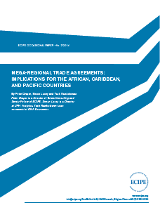
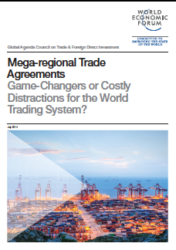
Presentation based on two recent reports

Slide 4
Background
Growth of regionalism in inverse proportion to relative stasis in WTO
Opportunities for advancing rules are higher in smaller, like-minded groups
Western leadership of the global trading system in play given the rise of China and other emerging markets
Combination of regulatory demand and geopolitical drive explains TPP and TTIP
Whether successful or not they present serious strategic challenges to outsiders, especially developing countries

Slide 5
Which mega-regionals matter most, and why?
Focus on the most systemically significant
Our definition (ECIPE report):
  3 or more countries
  25% or more of world trade
  WTO plus, or deep regulatory agenda
Only TTIP, TPP, and RCEP meet conditions 1 and 2
Only TTIP and TPP meet all three
Quite a number of other RTAs that are significant but not considered (eg Japan-EU; Canada-EU)

Slide 6
Which mega-regionals matter most, and why?
Review of impact studies
  Tariff liberalization impacts on negotiating parties predicted to be modest, since tariffs are generally not high to begin with
  Varies between TTIP, TPP states, and by sector
  Trade diversion effects on non-parties similarly predicted to be relatively small
    Again varying according to sector and negotiation
    Owing to high trade complementarities between ACP states and US/EU
  Some studies predict that trade creation (the GVC effect) may lead to net gains for outsiders

Slide 7
Which mega-regionals matter most, and why?
  Regulatory impacts predicted to be substantial
  Overall effects very difficult to predict, and any attempt to do so probably shouldn’t be believed
  But the regulatory agenda is very much part of the RTA landscape and won’t go away
  Effects could be of two types:
      Ratcheting up of standards through harmonization, leading to lock-out effect
      Reduction of market access costs through mutual recognition/equivalence

Slide 8
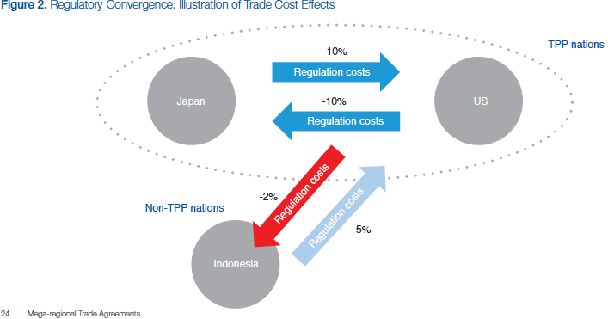
Which mega-regionals matter most, and why?
How mutual recognition could be beneficial to outsiders (WEF Report)

Slide 9
The regulatory agenda: A brief review
Sequencing is key to understanding: TPP leads; TTIP follows
Both aim for a ‘high standard agreement’
The US is central to both, therefore focus on US negotiating templates
TPP covers 29 chapters under a single undertaking
Our focus (ECIPE Report):
  Areas not covered by multilateral disciplines incorporating all members of the WTO
  Areas already covered by the WTO bearing closer scrutiny

Slide 10
The regulatory agenda: A brief review
Select WTO plus issues:
  Regulatory coherence – oversight councils/bodies and role of business groups
  SOEs – trade distorting practices or ‘competitive neutrality’; linkage to competition policy
  Government procurement – incorporation of GPA by reference (2011 text)
  Competition – exclusions; dispute settlement

Slide 11
The regulatory agenda: A brief review
  Investment – dispute settlement; capital controls, non-conforming measures
  E-commerce – freedom of access and competition; data privacy
  Environment – incorporation of MEAs; dispute settlement (enforceability)
  Labour – enforceability through DSM

Slide 12
The regulatory agenda: A brief review
Other issues expected to push the status quo:
  Goods market access – construction of tariff offers; rules of origin; entrenched lobbies especially in agriculture (eg Japanese rice)
  SPS – ‘science-based’ risk assessments; dispute settlement
  Services – negative vs positive lists
  IPR – US vs the rest on patents; US vs EU on GIs

Slide 13
Outcome scenarios
Definition of success? Ours (ECIPE report):
  Globally systemic view (not rooted in particular country interests)
  Agreement that all negotiating states are happy with
  Major liberalizing outcomes
  Key blockages in the international trading system addressed

Slide 14
Outcome scenarios
Full success
  Utopian scenario
  Not likely since many compromises entailed in both negotiations
Partial success
  Most likely
  Messier than US bilateral FTAs, but substantial liberalization and harmonization that developing country parties can live with
Failure
  Least likely
  Hinges on US trade politics, especially TPA

Slide 15
Strategic implications for Outsiders, especially developing countries
Calibrate to the outcome scenarios
‘Full success’ = ‘competitive liberalization’
  Watch China’s posture in particular (TPP; TISA; RCEP)
  Entails great pressure on ACP countries to sign up – bilaterally and in the WTO
  More pressure for reciprocity

Slide 16
Strategic implications for Outsiders, especially developing countries
‘Partial success’
  More wriggle room for ACP, but
  Failure of major western powers to decisively assert leadership of the trading system implies further WTO stasis
  Therefore more pressure on the bilateral front down the line, not least to compete with rise of emerging markets – particularly China
  Reciprocity still very much on the table, if not imminent

Slide 17
Strategic implications for Outsiders, especially developing countries
‘Failure’
  Western trade leadership foregone
  Acceleration of China’s potential leadership role
  Balancing option for ACP more pronounced
  But what does China want?
  Also, developed countries likely to intensify search for reciprocity with attendant implications for preferences

Slide 18
Strategic implications for Outsiders, especially developing countries
Policy options
  ‘Do nothing’ – always an option but it seems there is nowhere to hide
  Sequenced embrace of liberalization and regulatory reform, tailored to domestic capacities (ideal-type depiction)
    Unilateral reforms, driven by careful review of regulatory agenda contained in mega-regionals
    Regionally, through RTAs with neighbours and using appropriately designed models
    Regionally, with small developed economies that are not so threatening
    Regionally, with the major powers

Slide 19
Strategic implications for Outsiders, especially developing countries
  WTO
    Proactive, positive discussion of regulatory agenda
    Engage positively with the idea of plurilaterals on the basis of deliberations on the regulatory agenda
    Forge a consensus on how plurilaterals could proceed without harming own interests (eg: ‘plurilaterals code of conduct’)

Slide 20
Can the parties to mega-regionals assist?
They could
  Ensure that standards convergence does not lead to ‘lock-out’ by extending recognition of conformity assessments
  Direct more aid for trade funding towards standards-setting/implementation agencies in African LDCs
  Remove arbitrary distortions that inhibit African participation in GVCs
    Eg: Different rules of origin for LDCs versus non-LDCs

Slide 21
Thank you
peter.draper@tutwaconsulting.com

